Slide 1
Basic Statistics
Descriptives

Slide 2
Types of Statistics
Parametric versus Non-parametric
A brief reminder of types of data
All about that dependent variable
Descriptives versus Inferentials

Slide 3
Types of Data
Non-continuous / discrete
Nominal – data that is clearly defined into categories
Ordinal – ranked data
Continuous
Interval – data with equal space between numbers, no true zero
Ratio – data with equal space between numbers, a true zero

Slide 4
Parametric v Non-Parametric
Parametric – used on interval and ratio data, numbers that are continuous in nature
Requires more assumptions
Most of the stats we will use (ANOVA, regression)
Non-parametric – used on all data types (especially nominal, categorical)
Does not require same assumptions
Chi-square, log regression

Slide 5
Descriptives
Descriptive Statistics: create a picture of the data – describe
Mean – average of all scores
Variance – average distance of scores from the mean

Slide 6
Descriptives
Standard deviation – standardized variance (or standard average distance from the mean)
Standard error – standardized standard deviation (the estimate of SD for the population = SD / square root (N)).
For the love of all things: go watch the distribution bunnies video to understand the Central Limit Theorem and why we use standard error:
https://youtu.be/jvoxEYmQHNM

Slide 7
Descriptives
Histograms and Frequency Tables
Frequency table show each individual data point, and the frequency of each of those points
Histogram is a graphical display of a frequency table
Shows you the distribution of the data

Slide 8
Distributions
Distribution descriptors: Unimodal, bimodal, multimodal, rectangular (uniform) – describes the number of “humps” the distribution has.
Normal distributions – centered at the mean, unimodal, symmetric

Slide 9
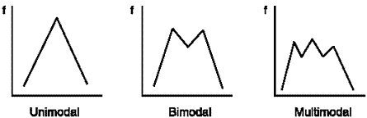
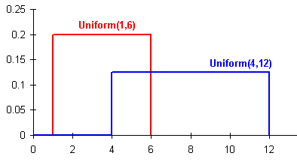
Distributions

Slide 10
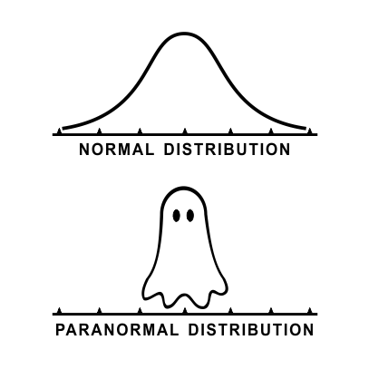
Distributions

Slide 11
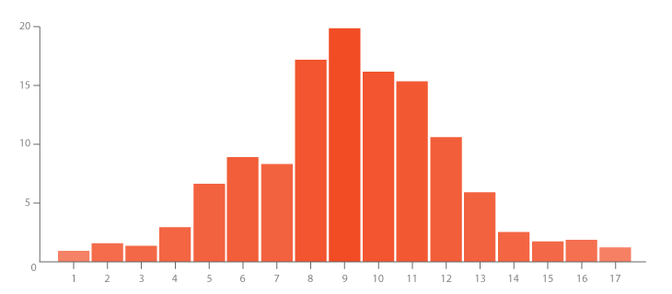
Distributions
frequency
values

Slide 12
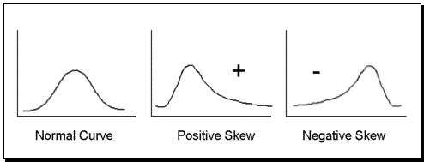
Distributions
Skew – how “not normal” a distribution is (how much it leans).
Negative skew: scores are on the top (right side) of the distribution, tail is on the left side, sometimes called a ceiling effect.
Positive skew: scores are on the bottom (left side) of the distribution, tail is on the right side, sometimes called a floor effect.

Slide 13
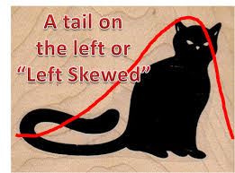
Distributions

Slide 14
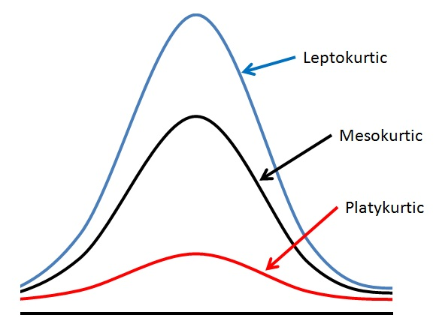
Distributions
Kurtosis – how different from normal in shape a distribution is (skinnier, flatter).

Slide 15
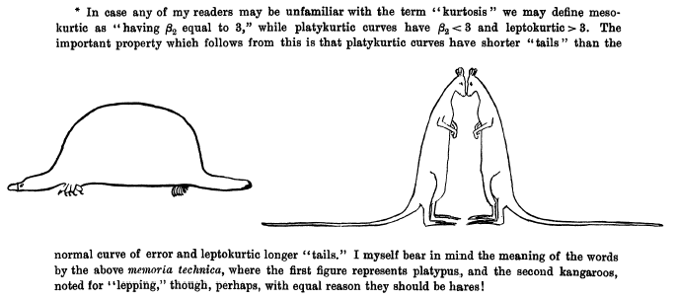
Distributions

